Slide 1
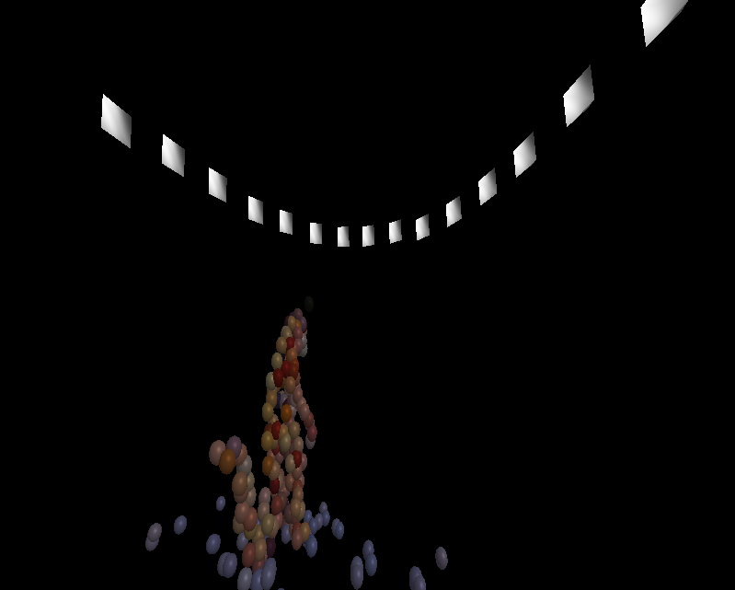
TSBB15 3D Reconstruction Group 2 “Epipolarna”

Slide 2
Modules
Main program and pipeline – Mattias
2D correspondence extraction – Alexander
Non-linear optimization – Martin
Visualization – Gustav

Slide 3
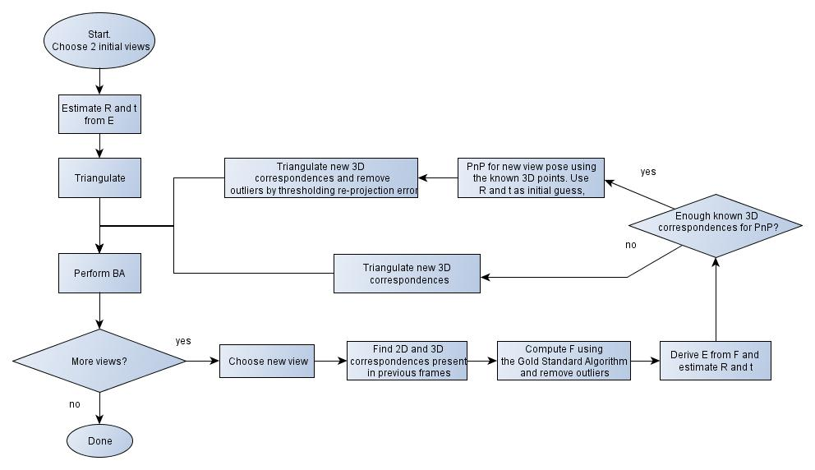
The 3D Reconstruction pipeline

Slide 4
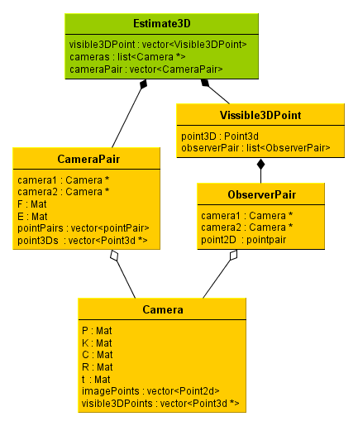
Data Structures
Camera data structure
2D <-> 3D
Camera pair & 2D <-> 3D

Slide 5
Problems
Difficult data set
Outliers
Long time before results are seen

Slide 6

Improvements
Chains?
1
2
3

Slide 7
2D point extraction
Find feature points, using Harris response
Minimum relative quality
Minimum distance
Calculate descriptor, using SIFT
Calculate correspondences, using Brute Force

Slide 8
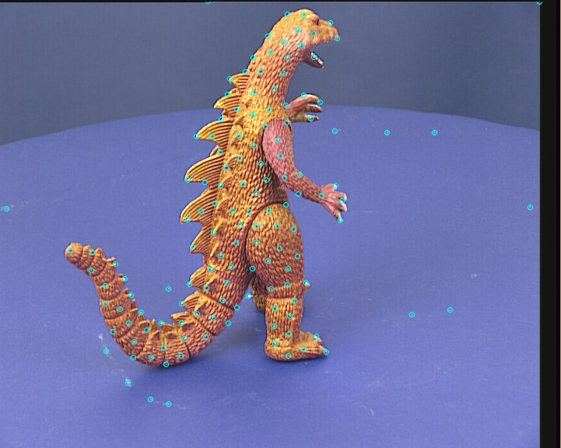
Feature Points

Slide 9
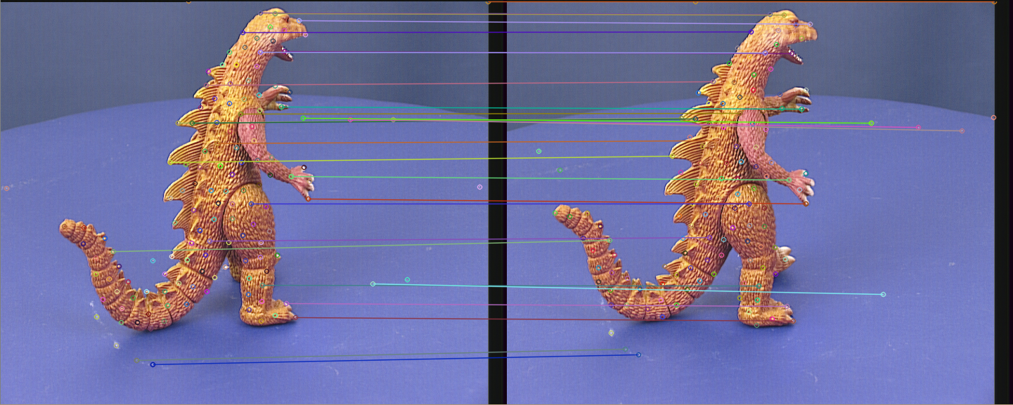
Corresponding Points

Slide 10
Initial Pose
Initial relation between cameras is calculated from the essential matrix, according to algorithm described in an epic compendium by Klas Nordberg.
Algorithm used as initial guess for PnP

Slide 11
Non-linear optimization
Implemented using the levmar API
Called three times in one pipeline iteration
Last step of Gold Standard algorithm
PnP pose estimation
Bundle adjustment
Minimizes squared re-projection error over specified parameters.

Slide 12
Rotation parameterization
Vector representation
Support exists in OpenCV: (cv::Rodrigues)
Allows for unconstrained optimization
Ambiguity in the mapping from parameter vector to matrix

Slide 13
Solving the PnP
Initial guess derived from F (R & t)
Use known correspondences from previous view
Threshold new points on re-projection error to remove outliers

Slide 14
Bundle Adjustment
Same rotation parameterization as the one used for solving the PnP
Computation time scales badly with the number of points and views
Dinosaur set takes more than ten hours to complete (30 points per view)
Slow mainly because
No sparse pattern is used for Jacobian estimation
levmar was not built using LAPACK

Slide 15
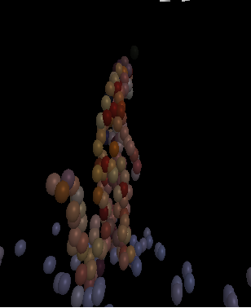
Visualization
Plot the estimated cameras
Plot the 3D points.
Points colored from original image data.

Slide 16
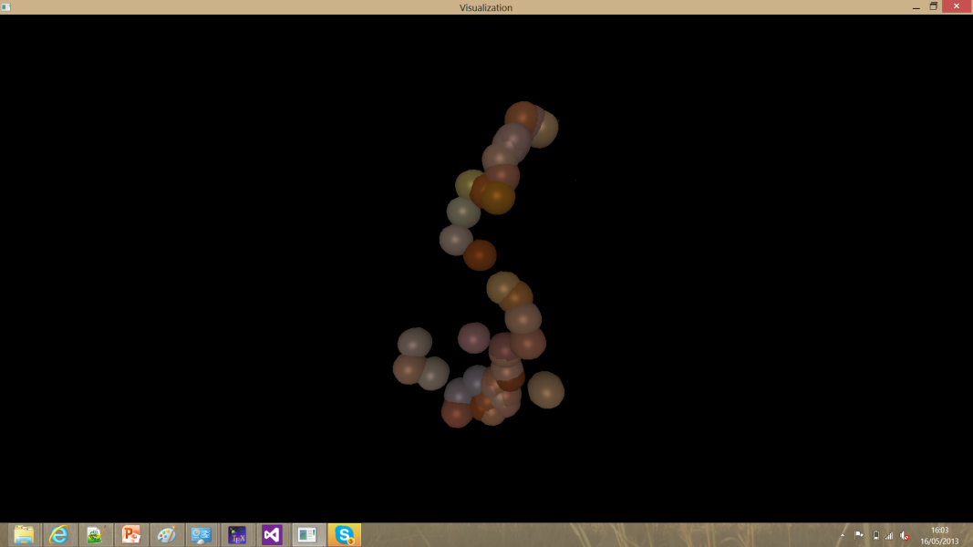
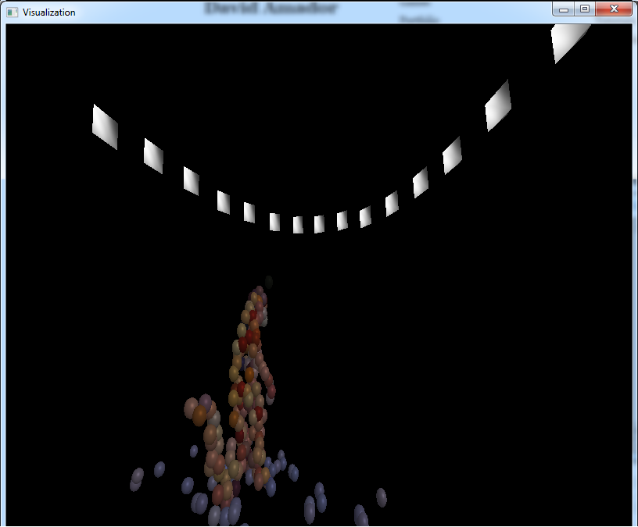
Evaluation
Slow, especially bundle adjustment step.
Very good results though.
Sensitive to outliers.

Slide 17
Results
Very slow for many cameras.
But it works.
It is awsome.

